Slide 1
OBJECT ORIENTED PROGRAMMING CONCEPTS USING JAVA

Slide 2
PROJECT REVIEW
2103A52L01
2003A52097
Java Course Project

Slide 3
ADDRESS BOOK
Store your contacts offline

Slide 4
Introduction
This is an Address Book application built by using Java’s Native GUI Framework called Swing, using swing and other packages available in java we were able to build an application that people can use to save their contacts in a Graphical User Interface that is not hard to understand but is so intuitive that even a 5 year old can use it to save and retrieve contacts, we also had to use java file stream api’s to allow the data to be stored inside the client instead of using a dbms system so that we don’t need to have internet access to use our app. The data stored in the files is stored according to Java’s format and so normal people can’t access the data. User defined exception is thrown if the user tries to add an already allotted contact. Exception handling is properly done to deal with any kind of unexpected exception

Slide 5
Objective
The main goal of this project is to create app for use in a user’s address books. The system should be as adaptable as possible, allowing it to be used in a variety of people. To learn about the various contacts that people have used. We need to figure out UI is better to implement, and then build an app that will help in achieving that goal. We need to look up how an Address book is built, use our own knowledge, or enquire on internet forums. The more varied your information sources are, the better the resulting method and, potentially, your details are available close to you. This project aims to make record updating, maintenance, and searching more user-friendly. will be able to retrieve the correct information from the files.

Slide 6
Technologies used:
JAVA SWING FRAMEWORK
JAVA FILE STREAMS
OBJECT ORIENTED PROGRAMMING CONCEPTS
EXCEPTION HANDLING

Slide 7
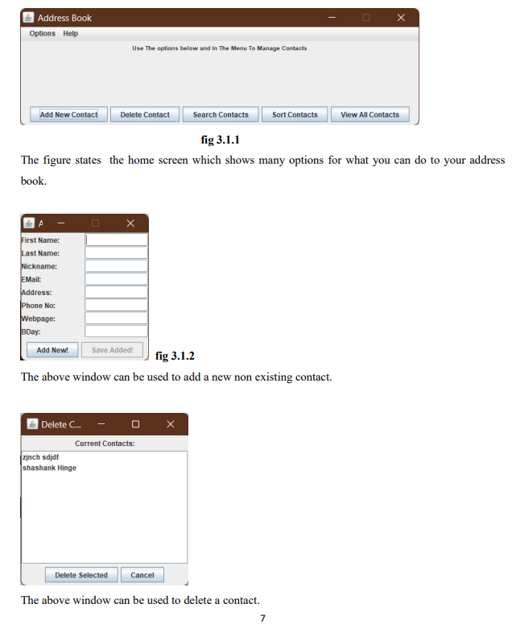
Object Interfaces:

Slide 8
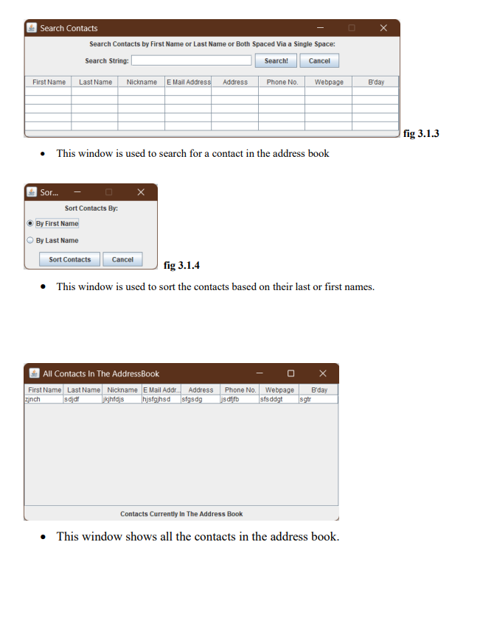

Slide 9
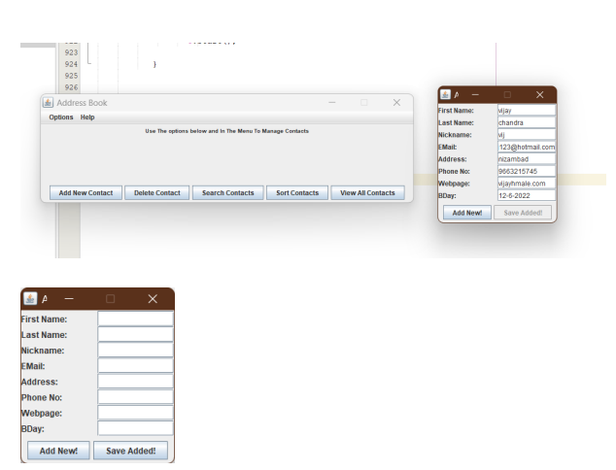

Slide 10
Conclusion:
Address books now-a-day have the advantage of modernization. Computer have done the work more easy. Computer is playing a important role in data management. Addresses are very important nowadays because we need to stay in contact with many of your people, you cant remember them all.. A software for computers makes the things many times easy, these are made as user friendly and to keep an check the details of your friends and family. So,these things are important and we have made things like these easy using our project

